Slide 1


Slide 2
Bank Registration System
RegisterNo:38110120
Name:Dasari.Srikanth

Slide 3
ABSTRACT
In these project the people able to register and login for bank system
In these each people able to login by their account number and password

Slide 4
After entering the account number and password correctly then it will check from the database if it available.
If the account number and password was not available in the database and if we not enter the username and password correctly then it will show “you are not a registered person please register”

Slide 5
Languages Learnt
Java
Mysql
Jdbc

Slide 6
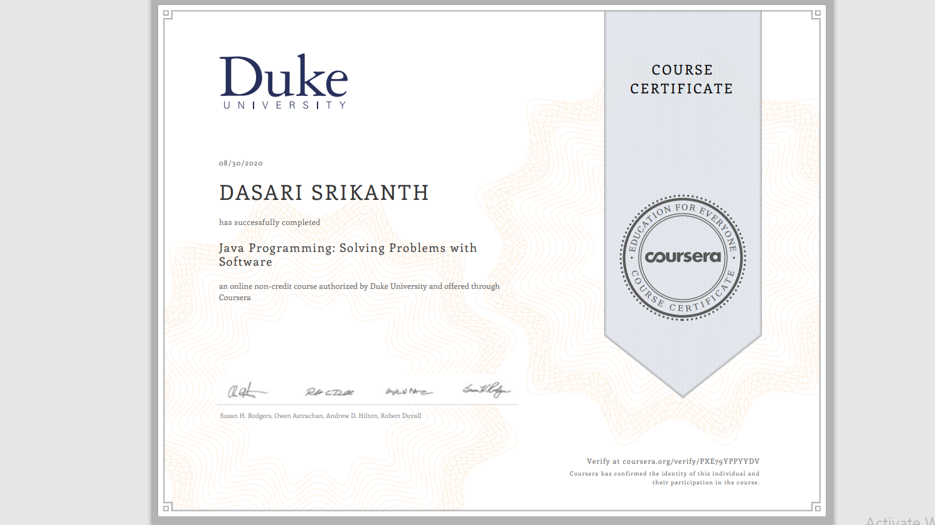
Certificate:

Slide 7
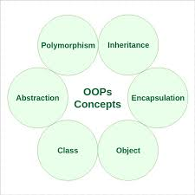
Topics Learnt In Java

Slide 8
Object:
Any entity that has state and behavior is known as an object.
It can be physical or logical.
Example: A dog is an object because it has states like colour, name, breed, etc. as well as behaviours like wagging the tail, barking, eating, etc.

Slide 9
Class:
A class can also be defined as a blueprint from which you can create an individual object. Class doesn't consume any space.
Example:Declaration of class
public class CLASSNAME
{
}

Slide 10
Inheritance
When one object acquires all properties and behaviour of parent object then
it is known as inheritance.

Slide 11
Polymorphism:
If one task is performed in many ways it is known as polymorphism. For example: to convince the customer differently, to draw something, for example, shape, triangle, rectangle, etc.
In Java, we use method overloading and method overriding to achieve polymorphism.

Slide 12
Abstraction:
Hiding internal details and showing functionality is known as abstraction. For example phone call, we don't know the internal processing.
In Java, we use abstract class and interface to achieve abstraction.

Slide 13
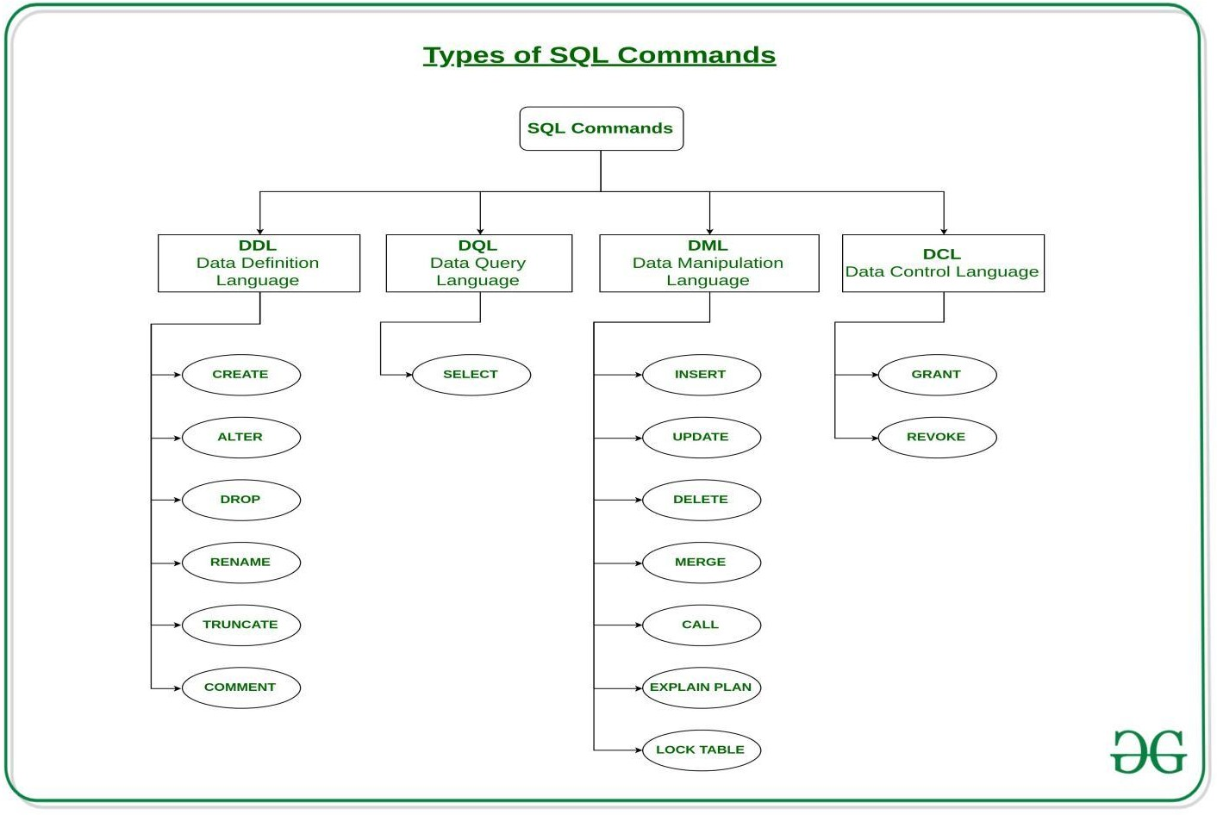
Topics Learnt in mysql

Slide 14
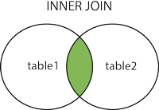
Different Types Of Joins:

Slide 15
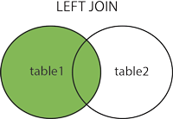

Slide 16
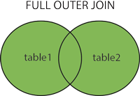

Slide 17
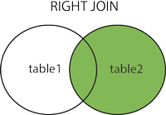

Slide 18
SQL Aggregate Functions:
AVG() – Returns the average value.
COUNT() – Returns the number of rows.
MAX() – Returns the largest value.
MIN() – Returns the smallest value.
SUM() – Returns the sum.

Slide 19
Html code:
Register.html
<html>
<head>
<style>
body {
background-color: #E6E6FA;
}
form
{
text-align: center;
}
h1
{
text-align: center;
}
</style>
</head>
<body>
<h1>REGISTRATION FORM</h1><br><br><br>
<form action="register" method="post">
NAME:<input type="text" name="name" placeholder="name"><br>
<br>

Slide 20
<br>
FATHER NAME:<input type="text" name="fname" placeholder="fathername"><br>
<br>
<br>
MOTHER NAME:<input type="text" name="mname" placeholder="mothername"><br>
<br>
<br>
ACCOUNT NUMBER:<input type="number" name="ano" placeholder="accountumber"><br>
<br>
<br>

Slide 21
PASSWORD:<input type="password" name="pass" placeholder="accountumber"><br><br><br>
sex:
<input type="radio" name="gender" value="male" checked> Male
<input type="radio" name="gender" value="female"> Female
<input type="radio" name="gender" value="other"> Other<br>
<br>
<br>
<input type="submit" value="Submit">
<input type="button" value="clear">
<br>
<br>
</form>
</body>
</html>

Slide 22
Index.html:
<html>
<head>
<title>Bank Details For Register or Login</title>
<style>
body {
background-color: #E6E6FA;
}
h1
{
text-align: center;
}
form
{
text-align: center;
}
</style>
</head>

Slide 23
<body>
<br>
<br>
<br>
<h1>BANK REGISTRATION SYSTEM</h1><br><br><br>
<form>
<button>
<a href="register.html">Register</a></button>
<br>
<br><br><br>
<button>
<a href="login.html">Login</a>
</button>
</form>
</body>
</html>

Slide 24
}
//out.println("NOT CORRECT USER");
if(c==0)
{
out.println("ENTER CORRECT USER NAME AND PASSWORD");
}
}
catch(Exception e)
{
out.println("ERROR:"+ e.getMessage());
}
}
}

Slide 25
Login.html:
<html>
<head>
<title>Login Details</title>
<style>
body {
background-color: #E6E6FA;
}
form
{
text-align: center;
}
h1
{
text-align: center;
}
</style>
</head>
<body>

Slide 26
<form action="login" method="post">
<h1>LOGIN FORM</h1><br><br><br>
<input type="text" name="accno" placeholder="Enter Account Numaber:"><br><br><br>
<input type="text" name="pass" placeholder="Enter Your Password"><br><br><br><br>
<input type="submit">
</form>
</body>
</html>

Slide 27
Javacode:
REGISTER.java:
public class register extends HttpServlet {
@Override
public void doPost(HttpServletRequest request, HttpServletResponse response) throws IOException {
response.setContentType("text/html;charset=UTF-8");
PrintWriter out = response.getWriter();
try {
String name = request.getParameter("name");
String fname=request.getParameter("fname");
String mname=request.getParameter("mname");
String sex=request.getParameter("gender");
String accountno = request.getParameter("ano");
String pass=request.getParameter("pass");
}
}

Slide 28
Class.forName("com.mysql.jdbc.Driver");
Connection con=DriverManager.getConnection("jdbc:mysql://localhost:3306/bharath","root","bharath");
con.createStatement().executeUpdate("insert into accountdetails values('"+name+"','"+fname+"','"+mname+"','"+sex+"','"+accountno+"','"+pass+"')");
out.println("<html><head> <style>h1{text-align: center;}body{ background-color: #E6E6FA;}</style></head><body><br><br><br><h1>YOUR REGISTRATION IS SUCCESSFUL FOR BANK</h1></html>");
}
catch (Exception e) {
out.println(e);
}

Slide 29
Login.java
*/
public class login extends HttpServlet {
@Override
public void doPost(HttpServletRequest request, HttpServletResponse response) throws IOException {
response.setContentType("text/html;charset=UTF-8");
PrintWriter out = response.getWriter();
String accountno=request.getParameter("accno");
String password=request.getParameter("pass");
int c=0;
try
{
Class.forName("com.mysql.jdbc.Driver");
Connection con=DriverManager.getConnection("jdbc:mysql://localhost:3306/bharath","root","bharath");
}

Slide 30
Statement stmt=con.createStatement();
String sql="select * from accountdetails";
stmt.executeQuery(sql);
ResultSet rs=stmt.executeQuery(sql);
while(rs.next())
{
if(accountno.equals(rs.getString(5)) && password.equals(rs.getString(6)))
{
//out.println("you are logged in");
out.println("<html><head> <style>h1{text-align: center;}body{ background-color: #E6E6FA;}</style></head><body><br><br><br><h1>YOUR LOGIN IS SUCCESSFUL FOR BANK</h1></html>");
c=1;
}
}
if(c==0)
{out.println("<html><head><style>h1{text-align: center;}body{ background-color: #E6E6FA;}</style></head><body><br><br><br><h1>YOUR ARE NOT REGISTERED FOR OUR BANK REGISTER FIRST THEN LOGIN TO IT</h1></html>");
}
}
catch(Exception e)
{
System.out.println("ERROR:"+ e.getMessage());
}
}

Slide 31
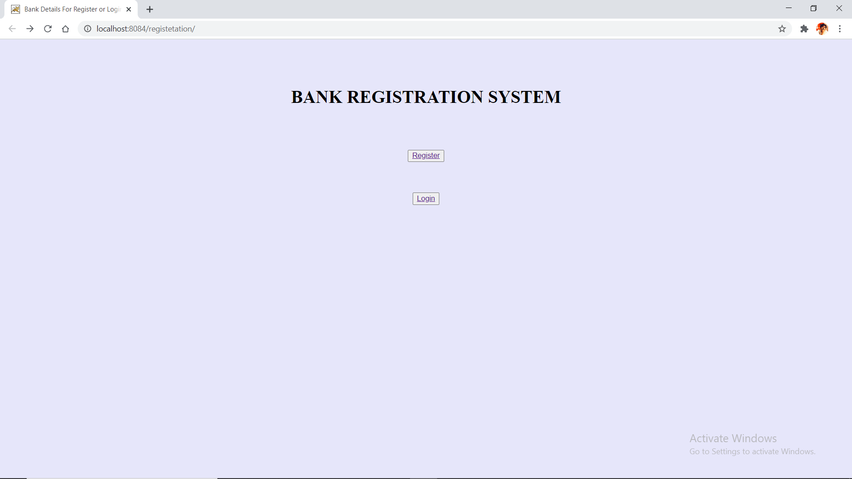
Output:

Slide 32
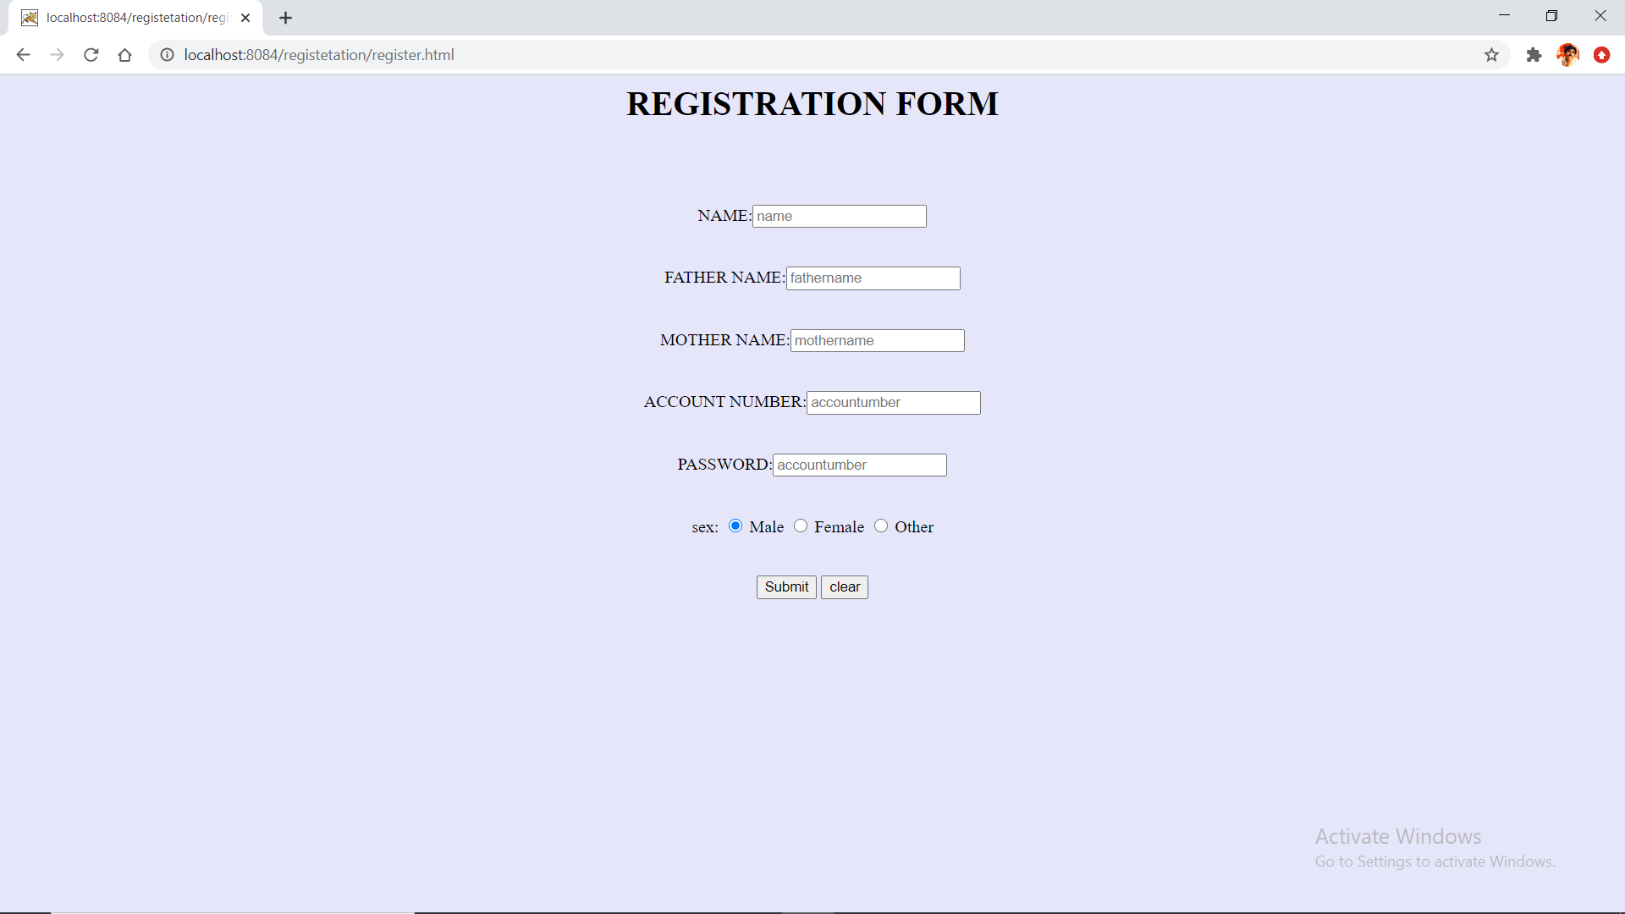
Register form

Slide 33
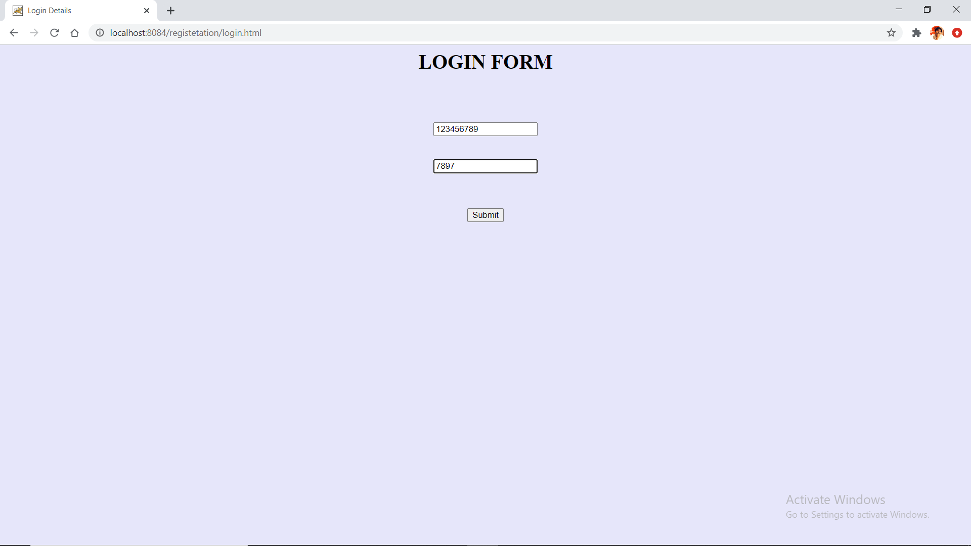

Slide 34
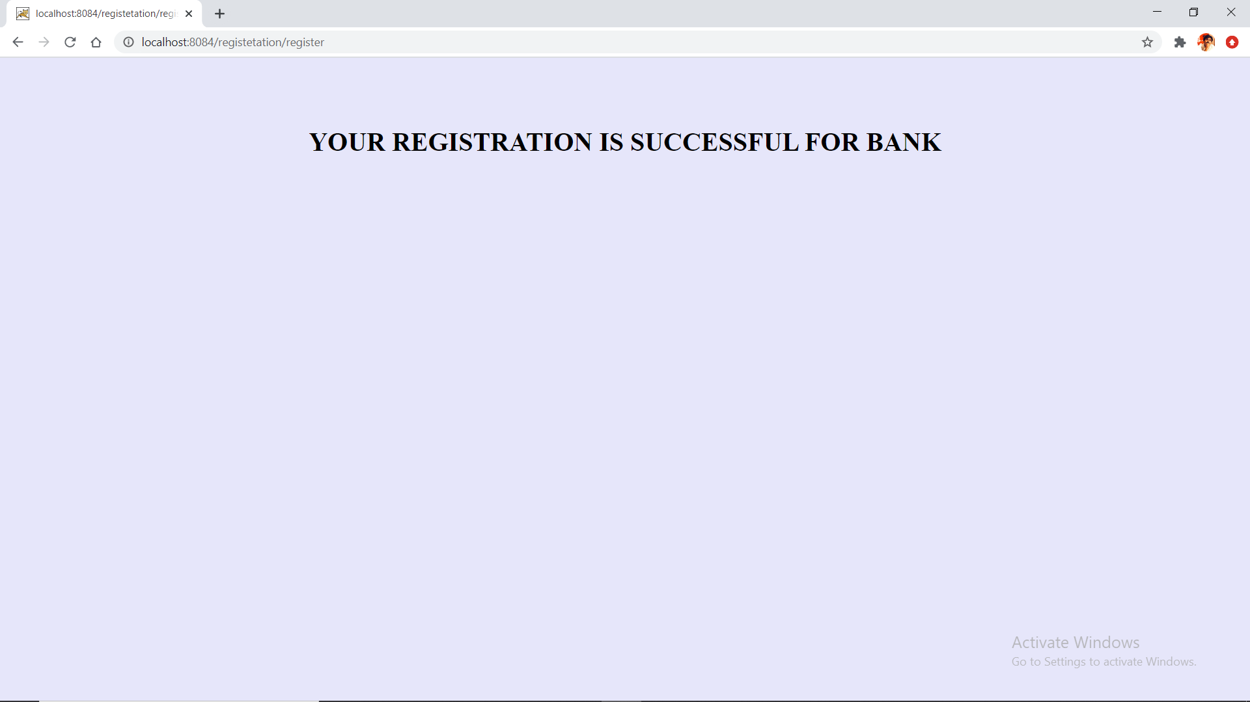

Slide 35
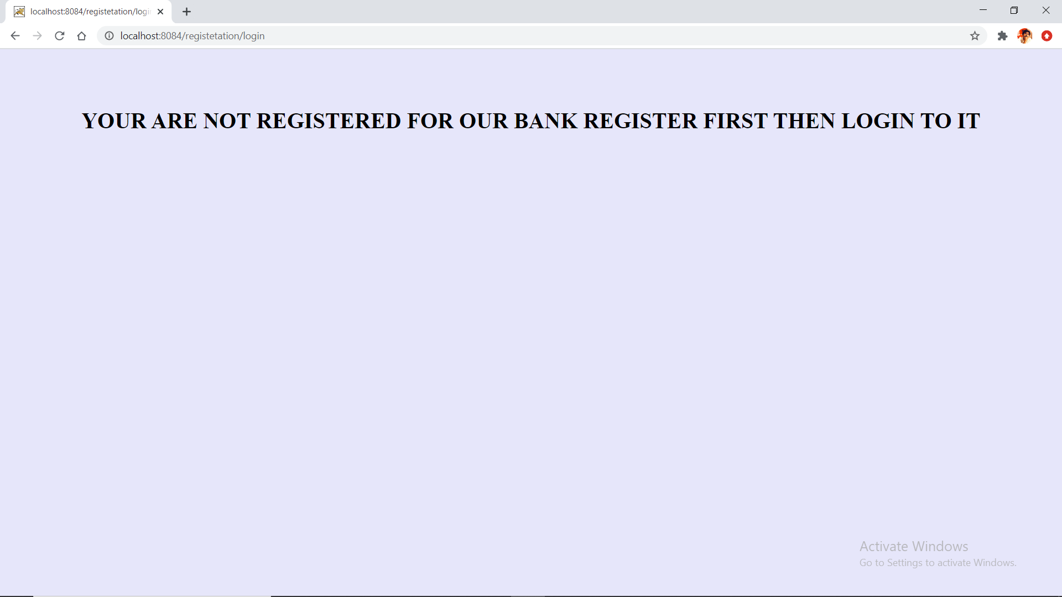

Slide 36
Conclusion
People able to regsiter and login online registration form

Slide 37
References:
https://www.w3schools.com/
https://www.javatpoint.com/
https://www.geeksforgeeks.org/

Slide 38


